Slide 1
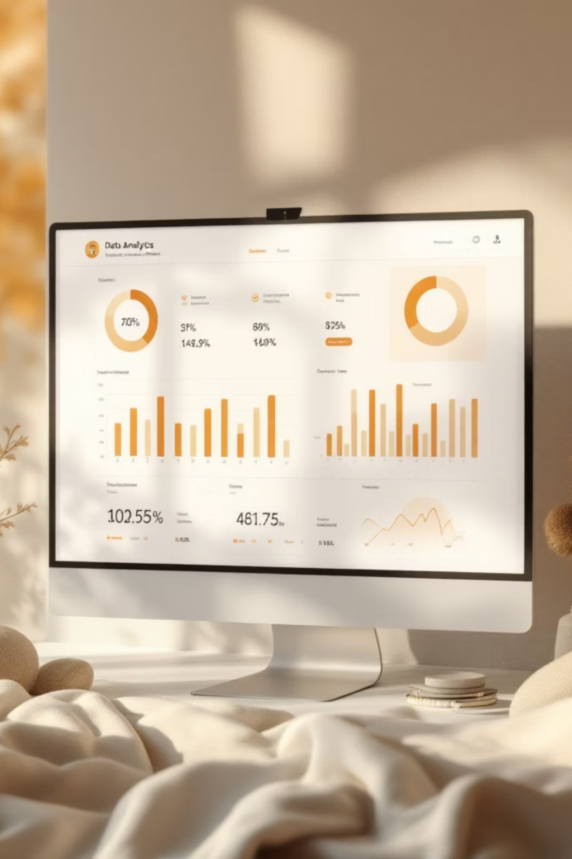
Customer Shopping Behavior Analysis
Identifying spending patterns, customer segments, and product preferences from 3,900 transactions to guide strategic decisions.

Slide 2
Dataset at a Glance
3,900
18
37
Purchases
Columns
Missing Ratings
Demographics
Purchase Details
Behavior
Age, Gender, Location, Subscription
Item, Category, Amount, Season
Discounts, Frequency, Ratings, Shipping

Slide 3
Data Preparation in Python
01
02
Load & Explore
Clean & Impute
pandas import, df.info(), .describe()
Median imputation for missing Review Ratings by category
03
04
Feature Engineering
Export to PostgreSQL
Age groups, purchase frequency days; dropped redundant promo_code_used
Loaded cleaned DataFrame for SQL analysis

Slide 4
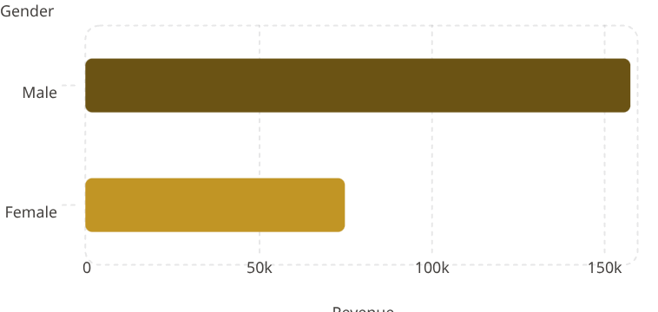
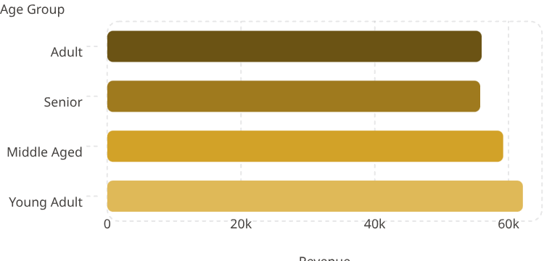
SQL Analysis: Revenue Insights
Revenue by Gender
Revenue by Age Group
Key Revenue Findings
Male customers generate 2.1x more revenue than female
Young adults are the top revenue age group

Slide 5

Discount-Dependent Products
Top 5 products highly dependent on discounts
Pants
Sneakers
Hat
Coat
Sweater

Slide 6



Top Products & Shipping
Top 5 products by Rating
Top products per Category
Shipping Comparison
Gloves
Sandals
Boots
Hat
Skirt
Jewelry
Blouse
Sandals
Jacker
Standard Shipping
Express Shipping
49.15%
50.85%

Slide 7
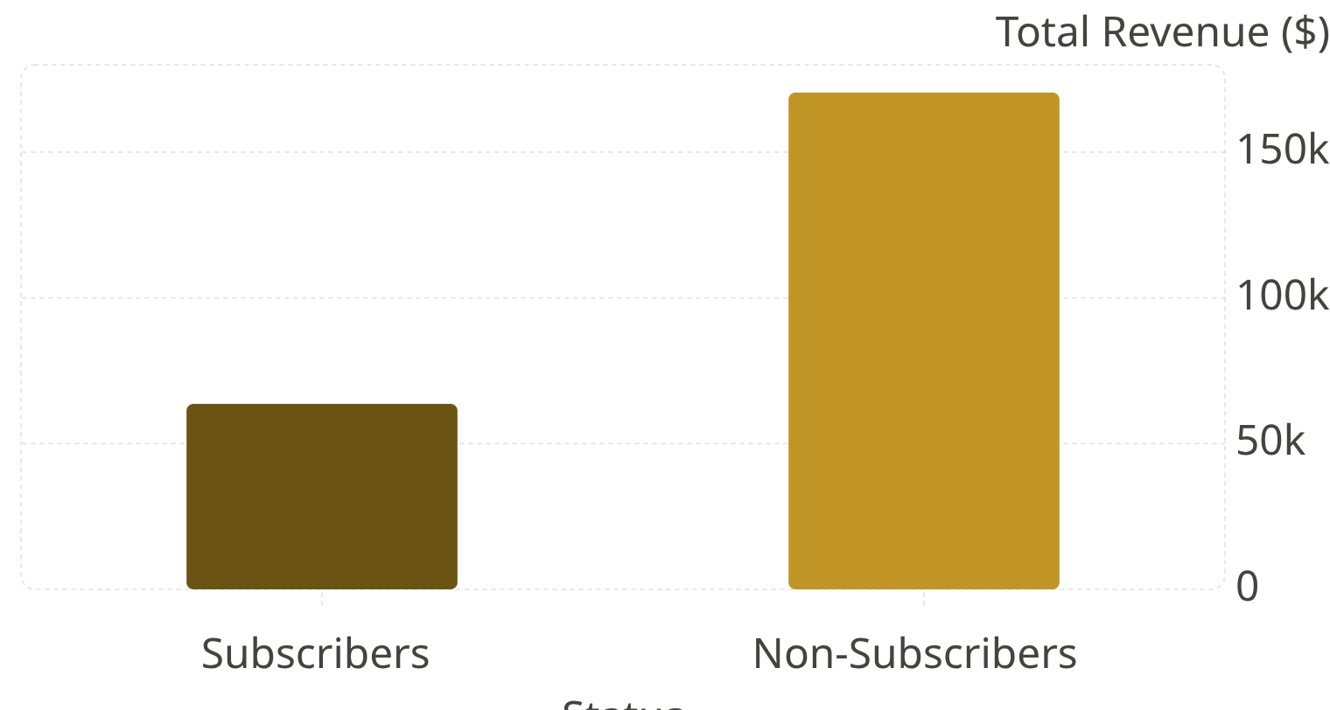
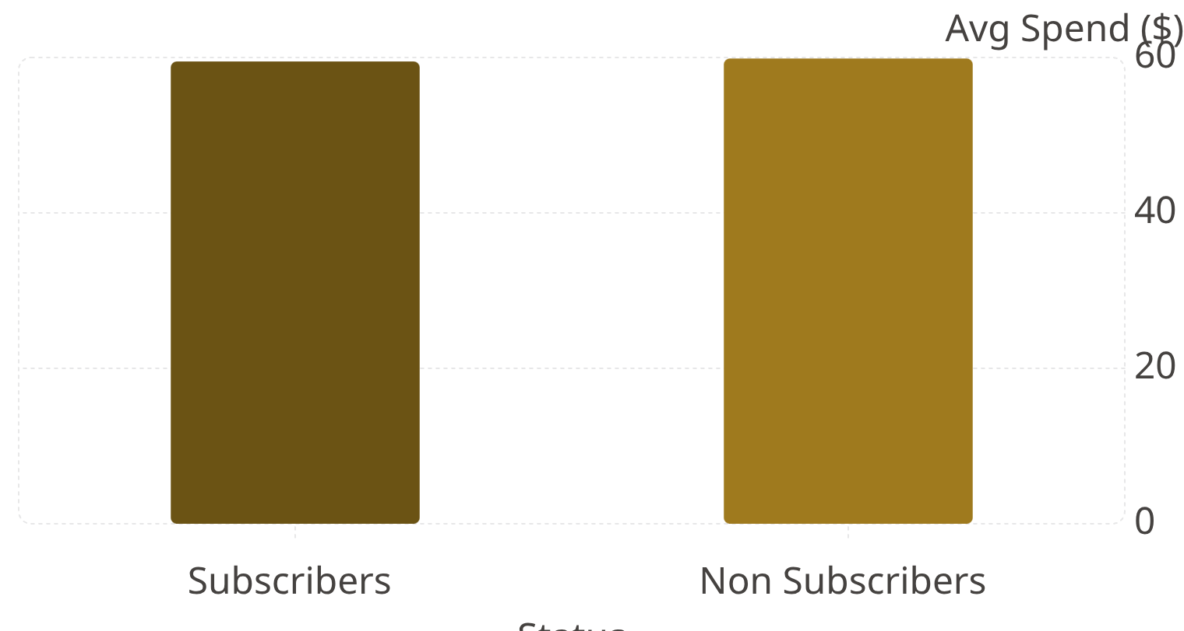

Subscribers vs. Non-Subscribers
170k
63.6k
Non Subscribers show higher total revenue and average spend.

Slide 8




Customer Segmentation
79.9% Loyal customers dominate – strong retention advantage.
2.1% New customer acquisition – funnel may need optimisation
701 returning customers ready to convert to loyal status.
Loyal·79.9%
·79.9%
·
New·2.13%
·2.13%
·
Focus: Convert returning → loyal, acquire new customers, maintain loyal base.
Returning·17.97%
·17.97%
·

Slide 9
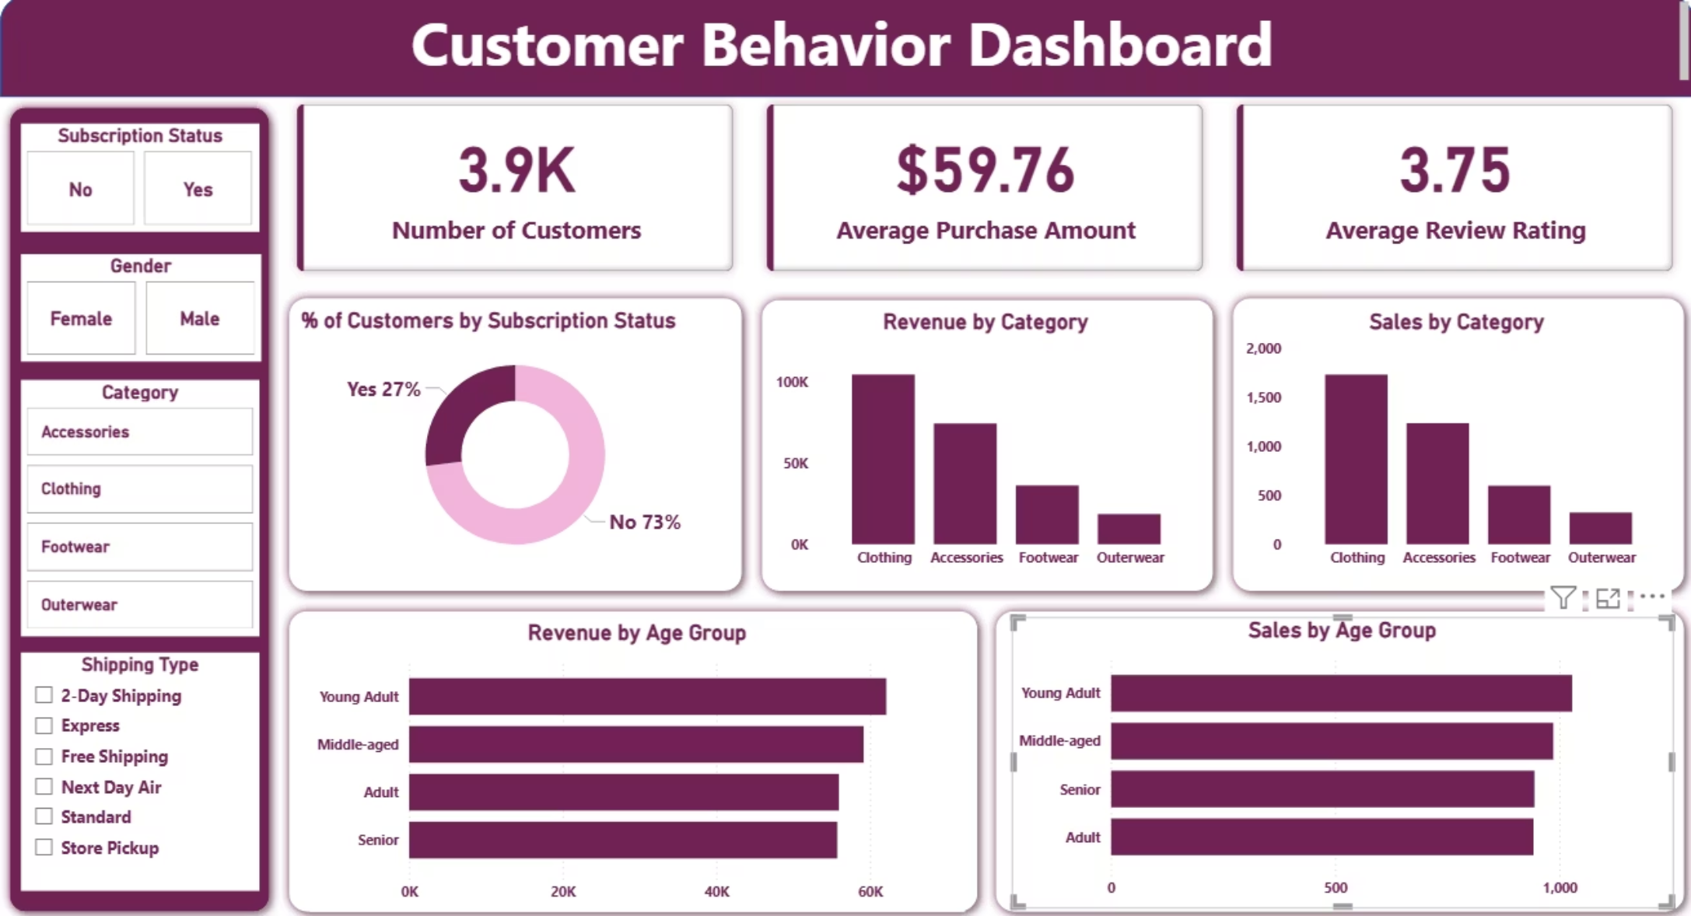
Power BI Dashboard
Interactive Insights
All findings visualized in a single Power BI dashboard for stakeholder exploration.
Revenue and Sales by age group
Subscription & loyalty segments
Revenue & Sales by Category

Slide 10

Business Recommendations
Boost Subscriptions
Loyalty Programs
Review Discounts
Promote exclusive subscriber benefits
Reward repeat buyers → move to "Loyal"
Balance sales boosts with margin control
Targeted Marketing
Product Positioning
Focus on high-revenue age groups & express-shipping users
Highlight top-rated & best-selling items in campaigns

